Slide 1
How program actually works
ywjeon

Slide 2
Compile
Linker
Loader
Source
Compiler
Inst
Program

Slide 3
Variable
Data type : Not stored in memory
Variable Name : Not stored (Shown as address)
int a = 3;
In runtime : data size just needed

Slide 4
Interpreter
Real time interpreting and calculate
Need more decoding process time
Memory usage can be less
#A* and D*?
#Similar to OS but OS prefer compile language

Slide 5
JIT
Just-In-Time compile
Compile each line, and reuse commonly used code
JIT is compile method that has advantages of interpreter

Slide 6
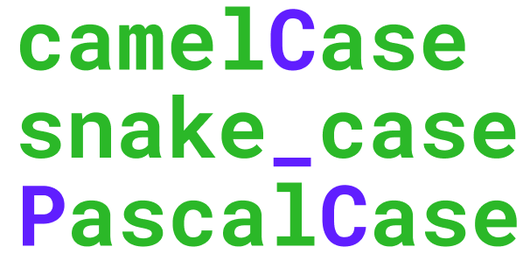
Variable Name?
In compiler, variable name don’t care
Variable name is only being for readability (strict in rust)
Auto variable name generator?

